Slide 1

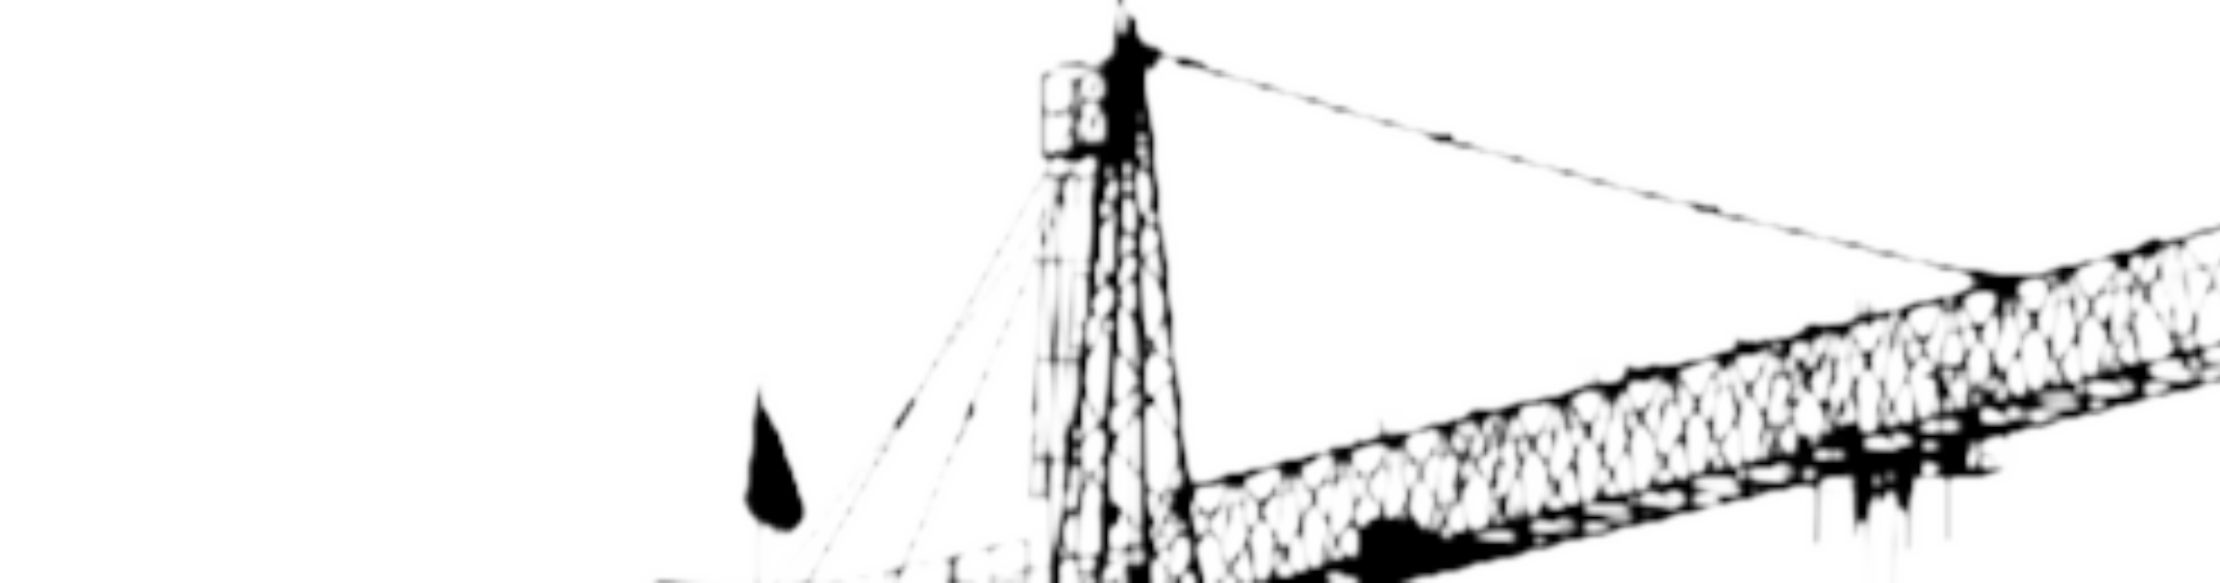
THUNDERBOLTS
2026
THUNDERBOLTS
SERV
DIGITAL
GRID
BORCELLE
A centralized platform that streamlines industrial
equipment maintenance—from service requests and
technician allocation to resource management, field
execution, and verified closure.

Slide 2


TEAM
A.GURU CHARAN
HMARSEHIMTHEBERS
VENKATARAMAN
PRANAV CHARAN.B SAHANA BALAJI SIVANEE.R
THUNDERBOLTS

Slide 3

PROBLEM STATEMENT
Industrial equipment service operations rely on disconnected systems to record and communicate service requests. This makes it hard to match the right technician, tools, and spare parts to each job, and offers little real-time visibility into technician assignments, machine status, and pending work. Delays and resource conflicts surface only after they disrupt the schedule, while service reports, photos, and completion records are collected and verified manually. The result is delayed maintenance, inefficient resource use, duplicated work, and no reliable machine service history.
Our platform solves this with one connected application that manages machines, requests, technicians, resources, documents, approvals, and completion records.

Slide 4
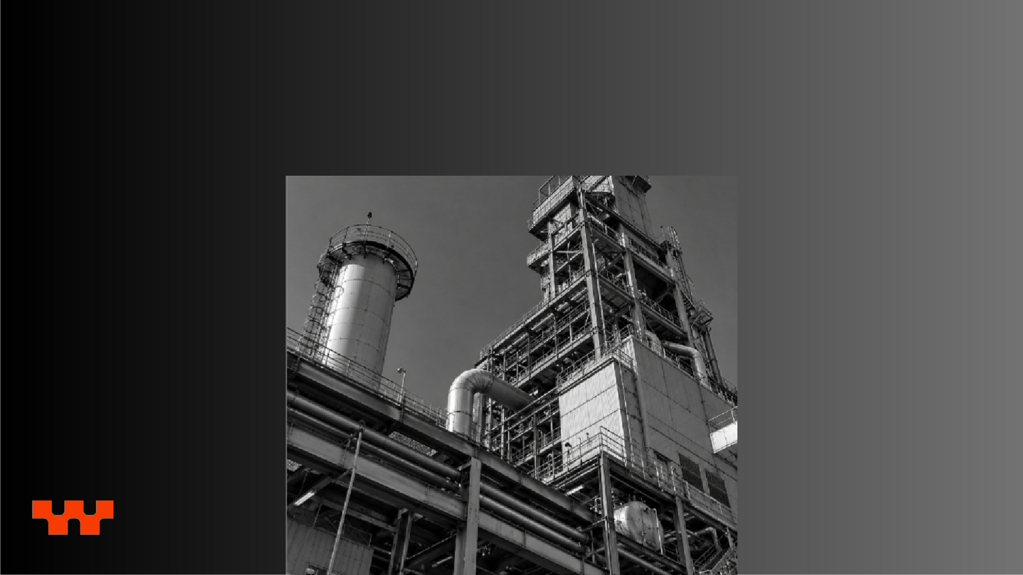

EXISTING
CHALLENGES
The current maintenance
process creates several
operational problems.
Fragmented information
Organizations have limited real-
makes it harder to
time visibility into technician
reconstruct machine
assignments, machine
service history and can result in delays, resource conflicts and SLA violations.
conditions, service progress and
pending requests. It is also
difficult to identify suitable
technicians, tools and spare
parts quickly.
THUNDERBOLTS

Slide 5


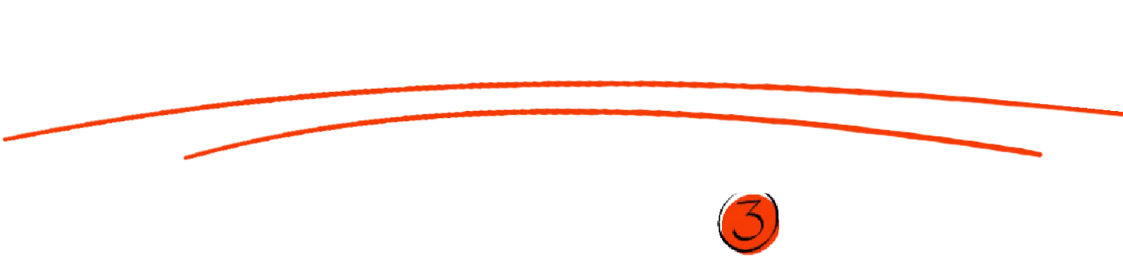



PROPOSED
THUNDERBOLTS
SOLUTION
Presentations are communication tools that can be used as
We propose a centralized Industrial Equipment Service
demonstrations, lectures, speeches, reports, and more. Most
Management Platform that brings the complete
of the time, they’re presented before an audience. It serves a
maintenance process into a single digital system.
variety of purposes, making them powerful tools for convincing
and teaching.
Instead of depending on spreadsheets, emails, messaging
A service request can be created, validated, assigned to the
applications and disconnected tools, the platform will
right technician, monitored during execution and finally verified
provide one place to manage machines, sites, service
and closed within the same system. The platform will also provide real-time visibility to managers and field personnel, helping them understand the current status of machines, ongoing service activities, technician assignments and pending requests.
requests, technicians, spare parts, tools, documents,
approvals and service history.

Slide 6


OBJECTI
VES
The primary objective of the proposed system is to make industrial equipment maintenance more efficient, organized, transparent and easier to monitor. The platform should support the complete lifecycle of a maintenance request, beginning with request creation and continuing through validation, approval, resource allocation, technician assignment, field execution, completion verification and closure.
Another important objective is to provide real-time operational visibility so that managers can quickly understand which machines require attention, which technicians are available, which requests are currently active and which activities are delayed or approaching their SLA limits.
The system should also reduce dependency on manual coordination by automating notifications, assignment workflows and exception alerts. Ultimately, the platform should provide a centralized source of information that improves
decision-making, minimizes delays
and maintains complete service history.

Slide 7
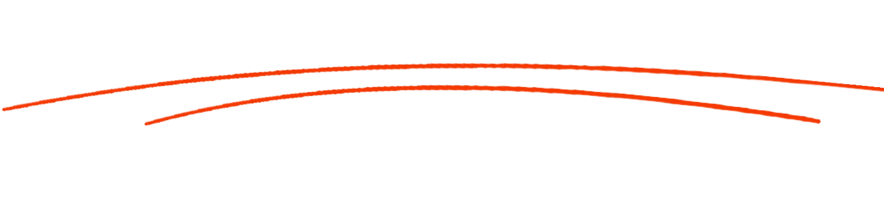

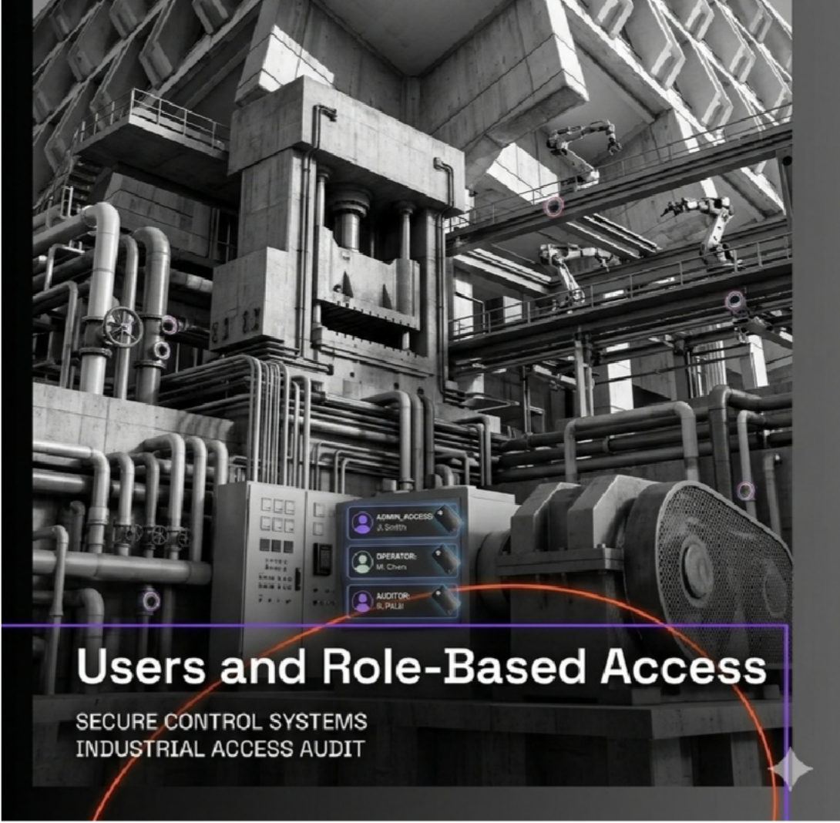


USERS AND ROLE-
BASED ACCESS
THUNDERBOLTS
The platform will support multiple categories of users, with
each user receiving access according to their
responsibilities. Customers or operations users can create
service requests, provide machine-related information and monitor the progress of their requests.
Operations managers can validate requests, approve maintenance activities, assign technicians and monitor the overall service process. Technicians can access their assigned tasks, accept jobs, update their current status, record work performed, report problems and upload photographs or other completion evidence. Administrators can manage users, machines, sites, technicians, resources and system configurations.
Role-based authorization is important because different users should not have unrestricted access to every function. For example, a technician should not be able to modify administrative settings, while an administrator should have broader management privileges. This provides both security and controlled access.

Slide 8
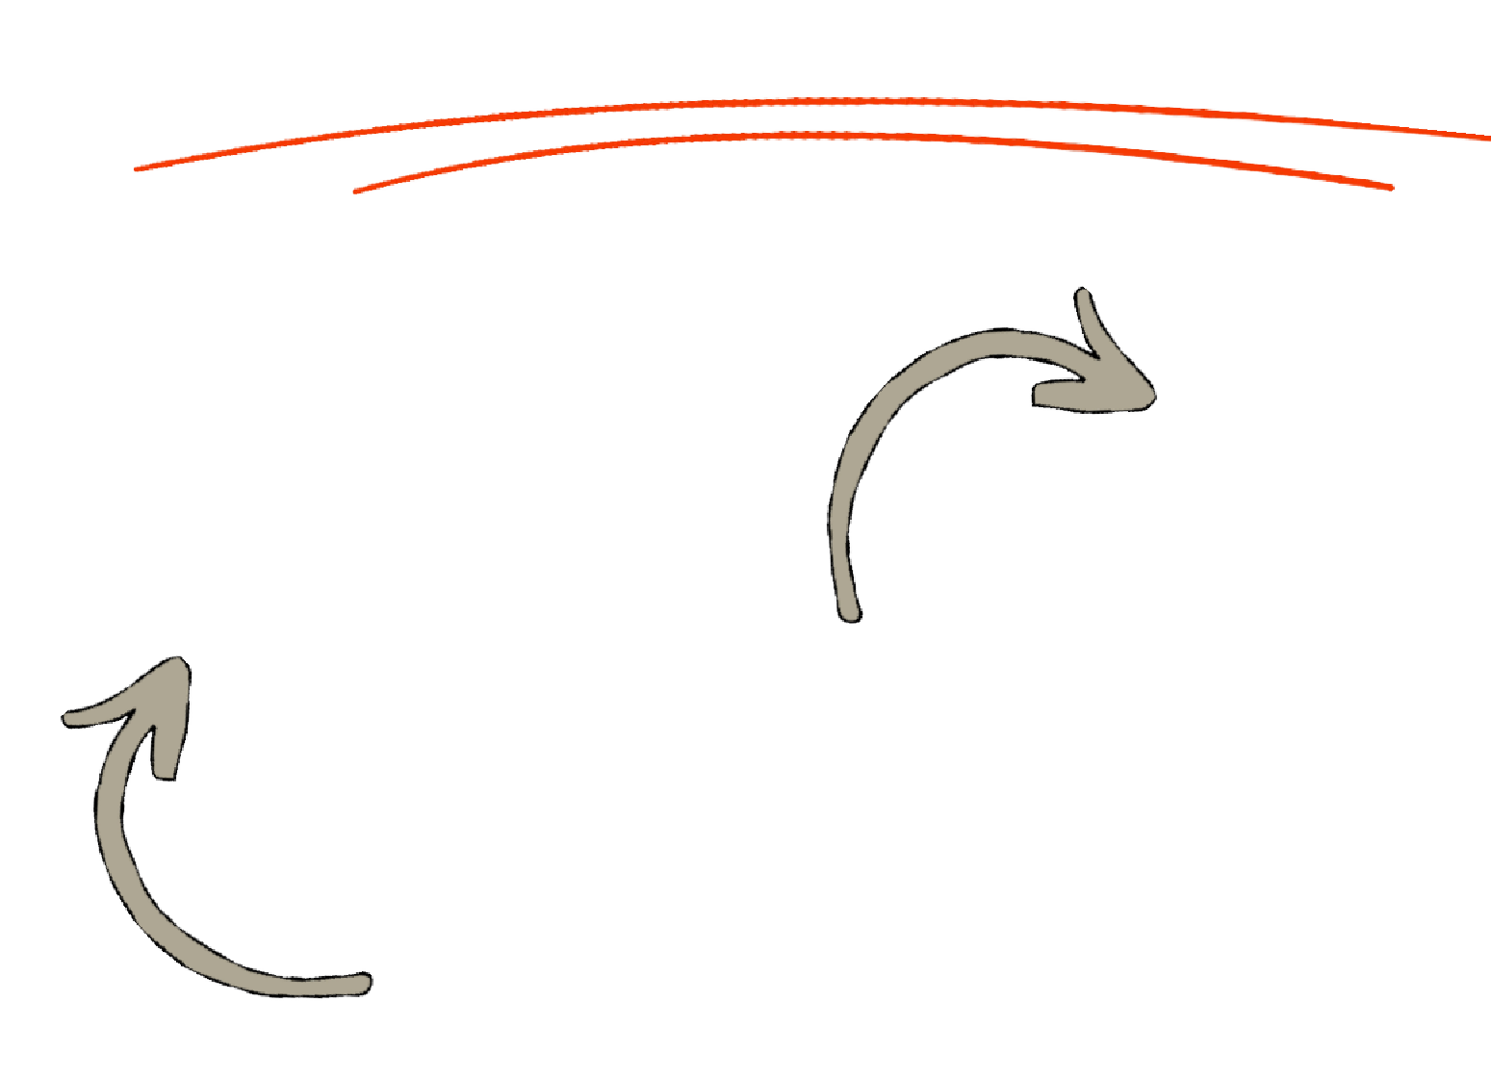


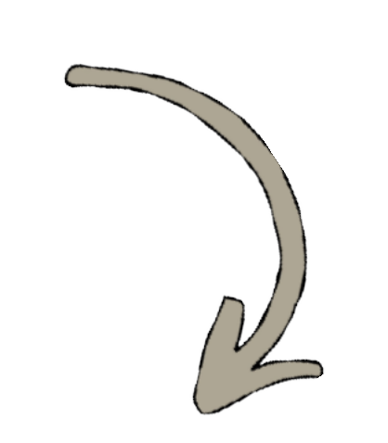

CORE ENTITIES MANAGED BY
THE PLATFORM
THUNDERBOLTS
The proposed platform will maintain centralized information
Each machine can be linked to a particular site and can maintain a complete record of previous maintenance activities. Service requests will contain details such as the affected machine, location, problem description, priority, required skills, required resources, assigned technician and current status.
about all important entities involved in industrial
maintenance operations. These entities include sites,
machines, service requests, technicians, spare parts, tools,
tasks, documents, approvals and service history.
SYSTEM
Technician records can contain their skills, availability and assignments, while resource records can track spare-part availability and other required equipment. Documents and photographs can be associated with individual service requests. By connecting these entities, the system creates a centralized information structure that allows users to understand the complete context of every maintenance activity.

Slide 9
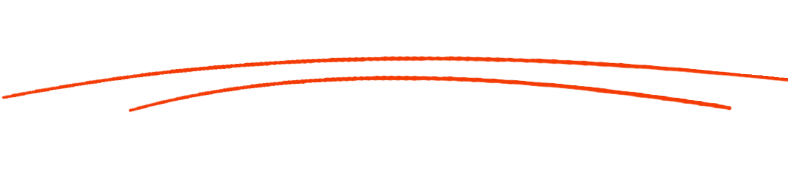


SERVICE REQUEST CREATI
ON
THUNDERBOLTS
The proposed platform will maintain centralized information about all important entities involved in industrial maintenance operations. These entities include sites, machines, service requests, technicians, spare parts, tools, tasks, documents, approvals and service history.
Each machine can be linked to a particular site and can maintain a complete record of previous maintenance activities. Service requests will contain details such as the affected machine, location, problem description, priority, required skills, required resources, assigned technician and current status.
Technician records can contain their skills, availability and assignments, while resource records can track spare-part availability and other required equipment. Documents and photographs can be associated with individual service requests. By connecting these entities, the system creates a centralized information structure that allows users to understand the complete context of every maintenance activity.

Slide 10

REQUEST VALIDATION AND
ROUTING
THUNDERBOLTS
Once a service request has been created, the system should validate the information before the request moves forward. Validation can include checking whether the selected machine exists, identifying the location of the machine, determining the priority of the request, understanding the required maintenance skills and checking whether the necessary resources are available.
After validation, the platform can identify suitable technicians based on factors such as their skills, current availability, location and workload. This helps ensure that a technician who is qualified and available is selected rather than relying entirely on manual assignment.
The routing process can also consider the urgency of the request so that critical maintenance activities receive appropriate priority. By combining validation and intelligent routing, the platform can reduce assignment delays, improve resource utilization and help ensure that service requests reach the right personnel.

Slide 11
RESOURCE AND CONFLICT
MANAGEMENT
THUNDERBOLTS
Effective maintenance requires more than assigning a technician. The system must also consider spare parts, tools and other resources required to complete the work. Before a task is assigned, the platform should check whether the required resources are available and, where appropriate, reserve them for the service request.
The system should also identify scheduling conflicts. For example, if the same technician has already been assigned to another maintenance activity at the same time, the platform should detect the conflict rather than allowing both assignments to proceed without warning.
Similar checks can be applied to limited tools or spare parts. If a required resource is unavailable, the system should raise an exception and notify the responsible user. This makes resource management more reliable and helps prevent avoidable delays during field execution.

Slide 12
APPROVAL AND ASSIGNMENT
WORKFLOW
THUNDERBOLTS
After validation and resource checks, the service request can move through an approval workflow. The appropriate manager or authorized user reviews the request and confirms that the maintenance activity can proceed. Once approval is granted, the system assigns a qualified technician and the required resources to the task.
The technician should then receive a notification containing the relevant job information, including the machine, location, problem, priority and expected activity. The system should maintain a timeline showing when the request was created, validated, approved and assigned.
management and field personnel. If a request is rejected or requires additional information, it can be returned to the appropriate stage instead of being lost. This structured approval and assignment process ensures that maintenance activities are controlled and traceable from the beginning.

Slide 13

TECHNICIAN TASK EXECUTI
ON
THUNDERBOLTS
Once a technician accepts an assigned task, the system should support the complete field execution process. The technician can update the task through different stages such as Assigned, Accepted, Travelling, On Site, Work in Progress and Completed. These status changes allow managers to understand the current progress of the maintenance activity without repeatedly contacting the technician
During the task, the technician can record important information about the work performed, observations, parts consumed, tools used and any additional problems discovered. The technician can also upload photographs, service reports and other supporting documents as evidence of the work.
Once the repair or maintenance activity is finished, the technician submits the completion information for verification. This creates a structured digital record of what actually happened during the field service activity.

Slide 14
EXCEPTION HANDLING AND SLA
MONITORING
THUNDERBOLTS
Real-world maintenance operations do not always follow the planned workflow, so the system must be capable of handling exceptions. One possible situation is that an assigned technician becomes unavailable or drops out of a task. In this case, the platform should flag the exception and help identify another qualified technician.
Another situation occurs when a required spare part or tool is unavailable. Instead of allowing the task to silently remain pending, the system should generate an appropriate alert so that operations personnel can take action.
SLA monitoring is also important. If a service request is approaching its allowed completion time, the system can generate a warning. If the SLA is exceeded, the system can raise an escalation or breach alert. These features ensure that operational problems are visible and can be addressed quickly.

Slide 15

COMPLETION VERIFICATION AND SER
VICE
HISTORY
THUNDERBOLTS
after the technician finishes the maintenance activity, the request should go through a completion verification process before it is finally closed. The technician can submit information describing the work performed along with photographs, documents, parts used and other evidence.
An authorized manager or responsible person can then review this information and verify whether the requested work has actually been completed. Once verification is successful, the service request can be marked as closed. All relevant information should remain stored as part of the machine's service history.
When users later access the machine, they should be able to see previous maintenance requests, completed work, technicians involved, resources used and supporting documents. This creates a reliable historical record and makes future maintenance planning and troubleshooting easier.

Slide 16

REAL-TIME DASHBOARD AND
NOTIFICATIONS
THUNDERBOLTS
The platform should provide a centralized dashboard that gives managers and operations teams a clear view of current maintenance activities. The dashboard can display the number of pending requests, active jobs, completed requests, machines requiring attention, available technicians, technician assignments, SLA risks and resource shortages.
Instead of searching through different spreadsheets or communication channels, users can obtain important operational information from a single interface. The dashboard can also highlight exceptions that require immediate attention, such as unavailable technicians, missing spare parts or overdue service requests.
In addition to the dashboard, the platform should provide notifications for important workflow events. Users can be notified when requests are created, approved, assigned, reassigned, delayed or completed. This combination of real-time visibility and notifications enables faster decision-making and better coordination.

Slide 17

SYSTEM ARCHITECTURE AND
EXTENSIBILITY
THUNDERBOLTS
The proposed solution should use a modular full-stack architecture so that the system can support current requirements while remaining flexible for future expansion. The frontend will provide interfaces for different user roles, while the backend will manage APIs, authentication, authorization, business rules, workflows, notifications and audit records.
A centralized database will store information about machines, sites, requests, technicians, resources, documents and service history. The architecture should also be designed for future integration with advanced technologies. AI or machine-learning capabilities could later support predictive maintenance or intelligent technician recommendations.
IoT devices could provide real-time machine sensor information, while maps could support location-based technician routing. Mobile applications, analytics, real-time communication and cloud services can also be integrated as the platform grows.

Slide 18

END-TO-END SOLUTION FLOW
THUNDERBOLTS
The complete platform will provide an end-to-end workflow for managing industrial equipment maintenance. The process begins when a user creates a service request for a machine and provides information about the problem and priority. The system validates the request and identifies suitable technicians and required resources.
After approval, the technician and resources are assigned and the technician receives a notification. During execution, the technician continuously updates the task status and records work performed. If a technician becomes unavailable, a spare part is missing or an SLA is at risk, the system generates an exception and supports corrective action.
After completing the work, the technician uploads evidence and submits the task for verification. Once the work is verified, the request is closed and the complete activity is stored in the machine's service history and audit trail. This creates one transparent lifecycle from request creation to final closure.

Slide 19
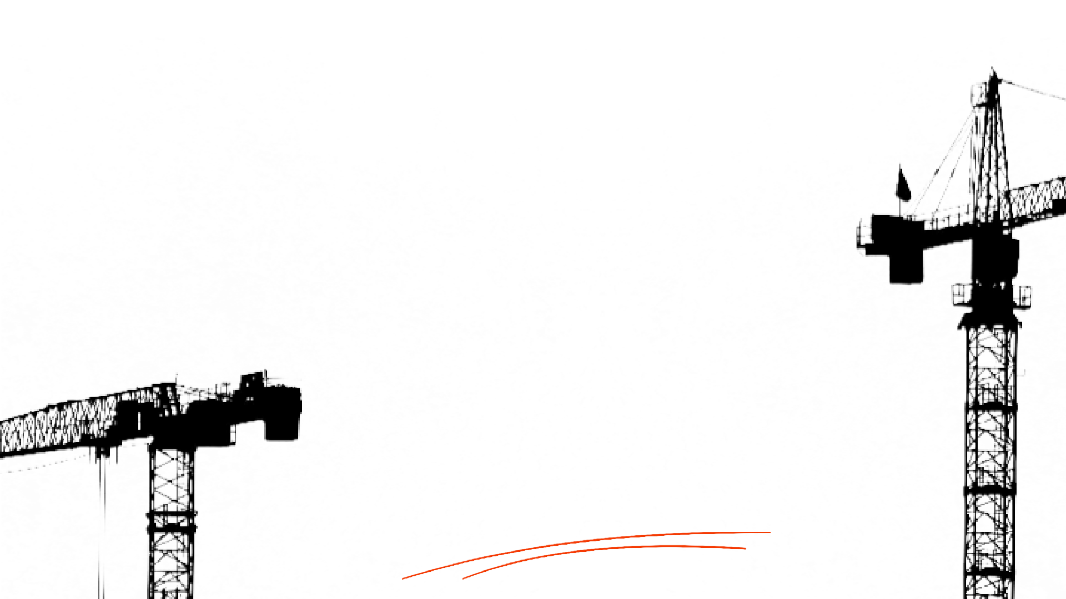
THUNDERBOLTS
2026
THUNDERBOLTS
THANK
For your
attention
YOU

